Slide 1
Paper Title for the 2026 Antenna Measurement Techniques Association (AMTA)
Ken Arkind¹, Captain Ken Marvin², Chuck May³, Joe Pape⁴, Lloyd Schonbrun⁵
¹Sanders Associates, Inc., Nashua, New Hampshire, USA
²Rome Air Development Center, Rome, New York, USA
³Naval Electronic Systems Engineering Activity (NESEA), St. Inigoes, Maryland, USA
⁴Scientific-Atlanta, Inc., Atlanta, GA, USA
⁵TRW Electronic Systems Group, Redondo Beach, California, USA
November 2, 2026

Slide 2
Presentation Suggestions
Please use this template for your presentation.
Design Clarity
Keep it Simple: Use a clean and uncluttered layout. Limit the amount of text and focus on key points.
Visual Hierarchy: Use headings, bullet points, and varying font sizes to guide the viewer’s eye through the presentation.
Use Visuals Effectively
Incorporate Figures and Images: Use graphs, charts, and images to illustrate your points. Visuals can help convey complex data more clearly.
Color Contrast: Ensure good contrast between text and background colors for readability.
Please use standard template fonts (Times New Roman)
Arial or Calibri are suitable sans serif fonts.

Slide 3
Presentation Suggestions
Content Organization
Logical Flow: Organize content in a logical sequence (e.g., Introduction, Methods, Results, Conclusion).
Limit Text: Aim for concise explanations. Use short sentences and avoid jargon where possible.
Practice Your Presentation several times. Be sure you can finish in 15 minutes
Engage with Attendees: Be prepared to explain your presentation and answer questions. Practice your pitch to convey your research succinctly.
Know Your Audience: Tailor your explanations based on the attendees’ backgrounds and interests.
Add a QR-code with additional information

Slide 4
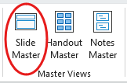
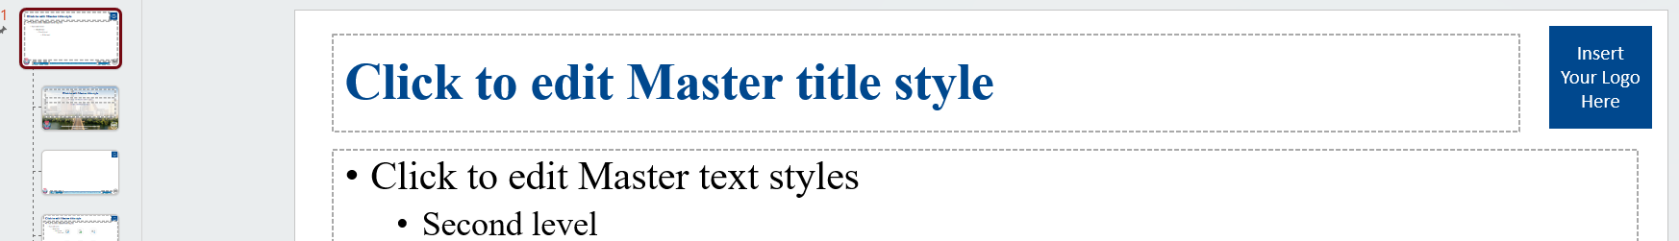

Presentation Suggestions
Insert your company logo in the upper right corner as indicated.
Open the slide master under View : Slide Master
Select the first large Slide Master and replace the text box with your logo.
Please do not make any other changes to the master template.
Click the Close Master View button.
4

Slide 5
Presentation Suggestions
The template default uses the Times New Roman font.
Arial or Calibri are also acceptable
While MS Power Point will scale fonts, try to keep fonts at least 16 point at smallest
15 slides are appropriate for a 15-minute presentation
5

Slide 6
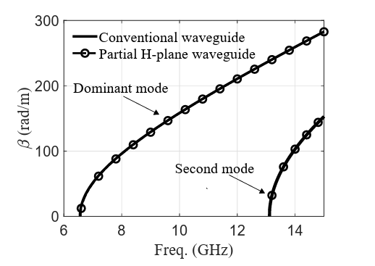
Presentation Suggestions
Integrate text with visuals to have better impact on your presentation.
Relying solely on text will not effectively captivate attendees
Ensure figures have legible axes/labels (recommend 14-pt or larger equivalent font on slide)
6

Slide 7
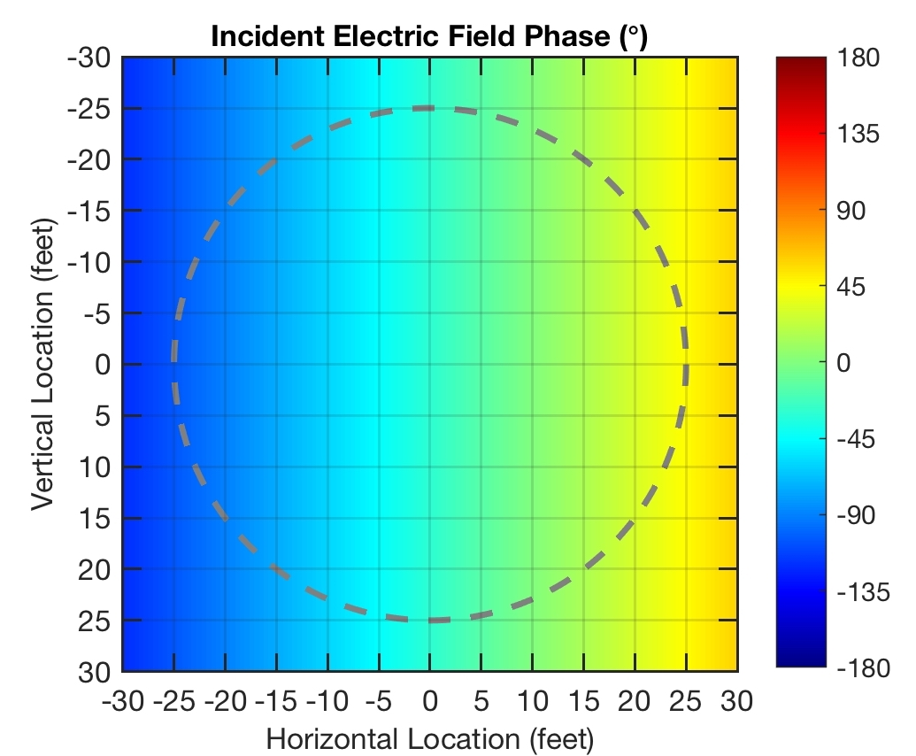
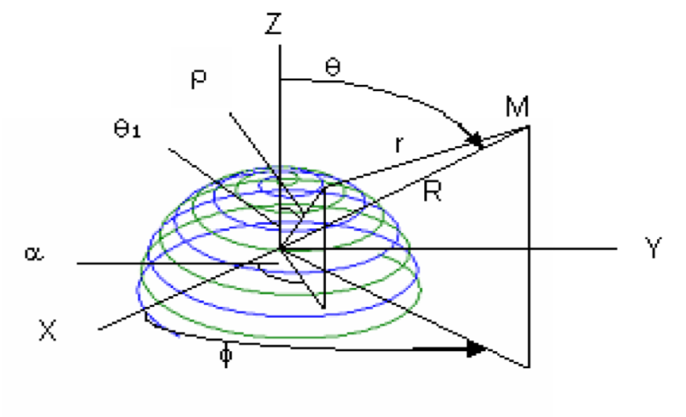
Figure Guidelines
Define symbols in figures as necessary
Ensure figures have legible axes/labels (recommend 14-pt or larger equivalent font on slide)
Maximize figure size for ease of viewing for audience
Common symbols don’t need defining
Add references if the material presented is not yours!
S. Lange, D. Schröder, C. Hedayat, C. Hangmann, T. Otto and U. Hilleringmann, "Investigation of the Surface Equivalence Principle on a Metal Surface for a Near-Field to Far-Field Transformation by the NFS3000," 2020 International Symposium on Electromagnetic Compatibility - EMC EUROPE, Rome, Italy, 2020, pp. 1-6, doi: 10.1109/EMCEUROPE48519.2020.9245697.

